Slide 1


Department of Computer Science and Engineering
MILK QUALITY PREDICTION BY USING MACHINE LEARNING AND IOT
ANITHA S [211419104012]
GAYATHRI M [211419104076]
HINDUJA N [211419104104]
Guide Name
Dr. T. Jackulin, M.E., Ph.D.,
Coordinator Name
Dr. Kavitha Subramani, M.E., Ph.D.,
1

Slide 2
Abstract
Milk adulteration by various impurities, such as water, whey, and urea, and some other harmful instruments are used for milk quality analysis.
These instruments are accurate but these are complex, expensive, inconvenient for field use, and require laborious skilled procedures to get the reading.
Portable sensors-based instruments working on direct/indirect transduction phenomena are also reported in the literature.
Most commonly, the conductive sensors with selective sensing films are used for detecting the milk impurities but such sensors require calibration and show drift due to aging.
There is a need to develop a rapid, accurate, sensitive, and cost effective simple working detection system.
This article presents the theory, design, fabrication, and test results of an accurate and simple working prototype model of an across-conductance sensor for milk adulteration detection.

Slide 3
Literature Survey
Year | Author | Paper Details | Methodology | Merits/Demerits
2022 | Tarikul Islam, Arshi Salamat, Sandeep K.Singh, | Title:A Direct AC Cross Conductive sensor for Milk Quality Measurement Volume: 71 Issued on:2022 Journal: IEEE | Raman Spectroscopy: It showed a set of overlapping bands that were assigned to lactose, protein, and milk fats. Cryoscopy method: A thermistsor cryoscope is used to accurately determine freezing point of milk. Ac Cross Conductance Sensing Probe: Tests the adulteration of milk with good order of accuracy and precision. | Merits: It can be interfaced to a simple interfacing electronic circuit to give quick, stable and reliable results with minimum quantity of milk samples. Demerits: These methods are expensive, bulky

Slide 4
Literature Survey
Year | Author | Paper Details | Methodology | Merits/Demerits
2021 | Rupak Nagraik, Avinash Sharma, Deepak Kumar | Title: Milk Adulterant Detection Volume:33 Issued on:8,2021 Journal:Applied Science and Biotechnology | Conventional and Biosensor approaches:Biosensor is an analytical device which is composed of three components:A bio-receptor a transducer and a signal reading device. | Merits: Rapid and continuous measurement, High specificity. Demerits: They can be affected by environmental changes and contamination.

Slide 5
Literature Survey
Year | Author | Paper Details | Methodology | Merits/Demerits
2020 | Muhammad Arslan, Xuetao Hu | Title:Use of a smartphone for visual detection of melamine in milk based on Au @Carbon quantum dots nanocomposites. Volume: 272 Issued on:30,2019 Journal:School of Food and Biological Engineering,Jiangsu University,china. | Gold nanoparticles@Carbon quantum dots nanocomposites(Au@CQDs):It is designed for analyzing melamine in milk visually.Fluorescent emission of Au@CQDs enhanced with the increase of melamine concentration. | Merits:The approximated concentration of melamine adulterated in milk samples were detected visually by fluorescence standard array and smart phone. Demerits:Limit of quantification and limit of detection.

Slide 6
Literature Survey
Year | Author | Paper Details | Methodology | Merits/Demerits
2019 | Francesca Trimboli, Nicola Costanzo | Title: Detection of buffalo milk adulteration with cow milk by capillary electrophoresis analysis. Volume: 102 Issued on:7,2019 Journal:IEEE | Electrophoresis Method:The aim of this study was to develop a new, rapid, and robust capillary electrophoresis method for detecting and quantifying cow milk in buffalo milk by exploiting cow α-lactalbumin as a marker of adulteration. | Merits:To detect possible fraudulent addition of cow milk to goat, ewe, or buffalo milk.. Demerits:When cow and buffalo whey protein profiles were overlaid, a specific cow fraction was clearly discernible.

Slide 7
Problem Statement
Milk Quality is one of the major factors in our healthcare domain. There are lot of people who are actively having milk. So it is necessary to know the quality of the milk.
Most commonly, the conductive sensors with selective sensing films are used for detecting the milk impurities but such sensors require calibration and show drift due to aging .
The goal is to develop a machine learning model for Milk Quality Prediction, to potentially replace the updatable supervised machine learning classification models by predicting results in the form of best accuracy by comparing supervised algorithm . So this project can easily find out the Milk quality.

Slide 8
Proposed System
The proposed method is to build a machine learning model for the classification of milk quality. The process carries from data collection where past data related to milk quality are collected. Data mining is a commonly used technique for processing enormous data.
Machine learning is now applied where it reduces manual effort and a better model makes error less which leads to preventing problems.
The data analysis is done on the dataset, proper variable identification is done that is both the dependent variables and independent variables are found.
The proper machine learning algorithms are applied to the dataset where the pattern of data is learned. After applying different algorithms a better algorithm is used for the prediction of the outcome.

Slide 9
Software / Hardware used
Software Requirements:
Operating System : Windows
Tool : Anaconda with Jupyter Notebook
Hardware requirements:
Processor :Intel i3
Hard disk : minimum 80 GB
RAM : minimum 2 GB
Microcontroller :Arduino Atmega 328p
Sensors :Ph,Temperature,Turbidity,Colour
Electronic Display :LCD

Slide 10
Methodology used
Algorithms Used:
Random Forest Algorithm
Logistic Regression Algorithm
XG Boost Classifier Algorithm
MLP Classifier Algorithm

Slide 11
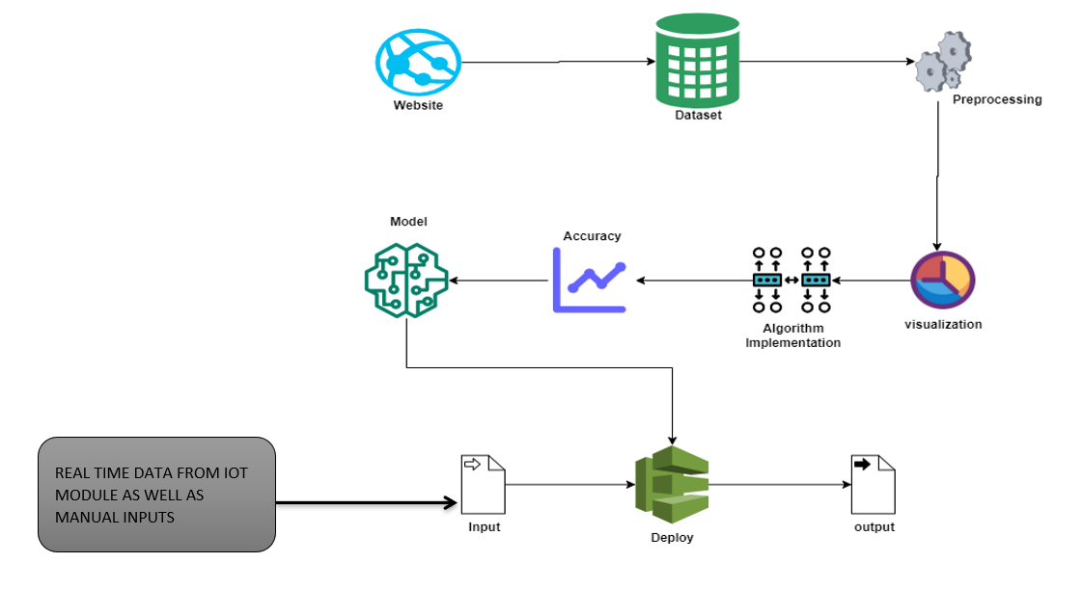
System Architecture

Slide 12
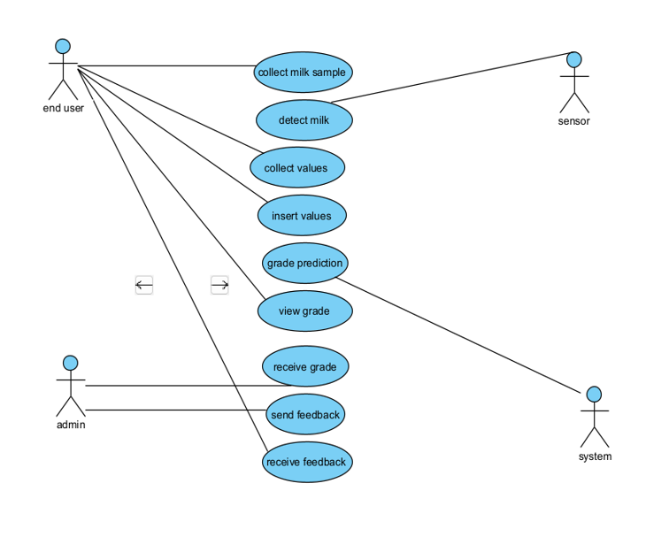
System Design – Use Case Diagram

Slide 13
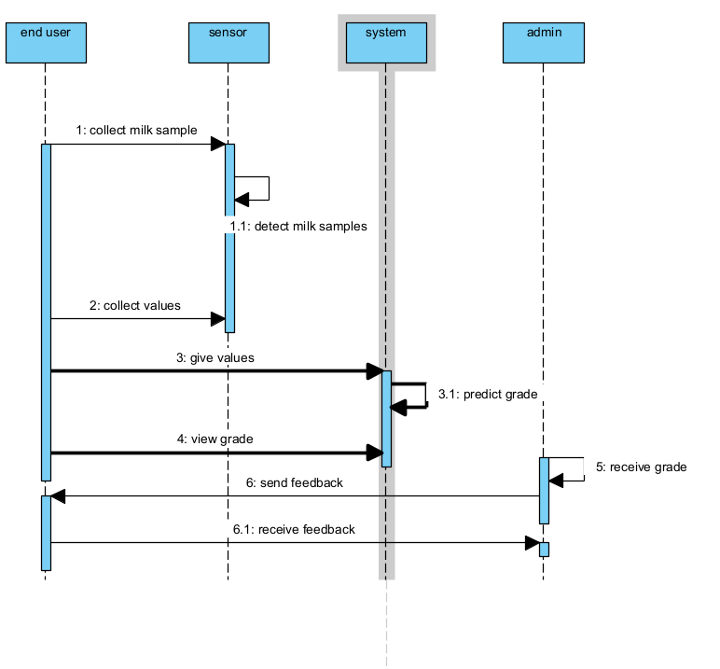
System Design – Sequence Diagram

Slide 14
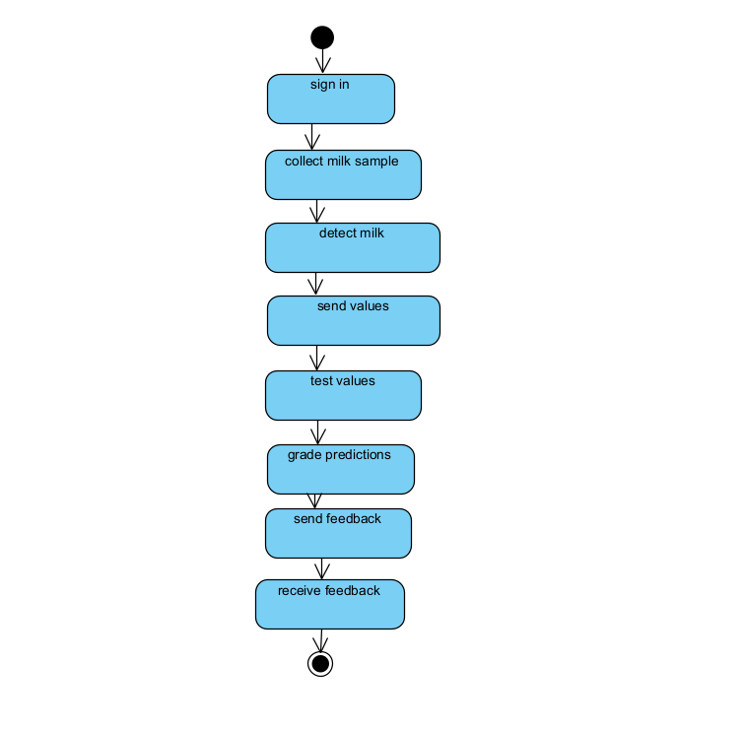
System Design – State Chart Diagram

Slide 15
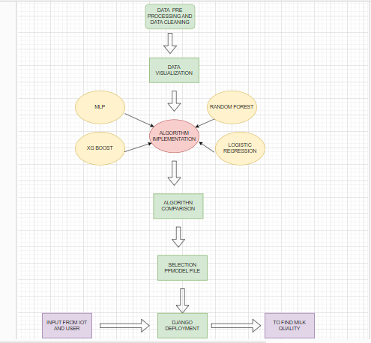
System Design – ER Diagram

Slide 16
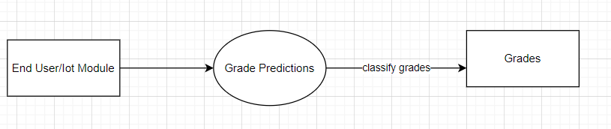
System Design – DF Diagram
LEVEL 0 DFD DIAGRAM

Slide 17
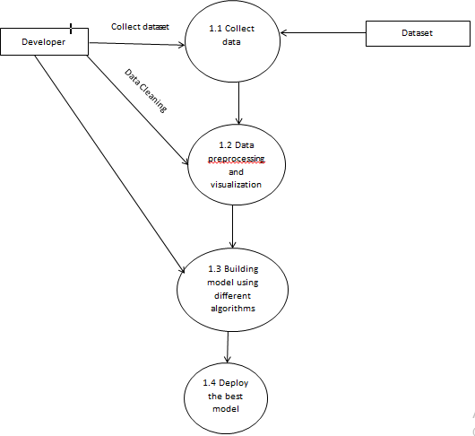
System Design – DF Diagram
LEVEL 1 DFD DIAGRAM

Slide 18
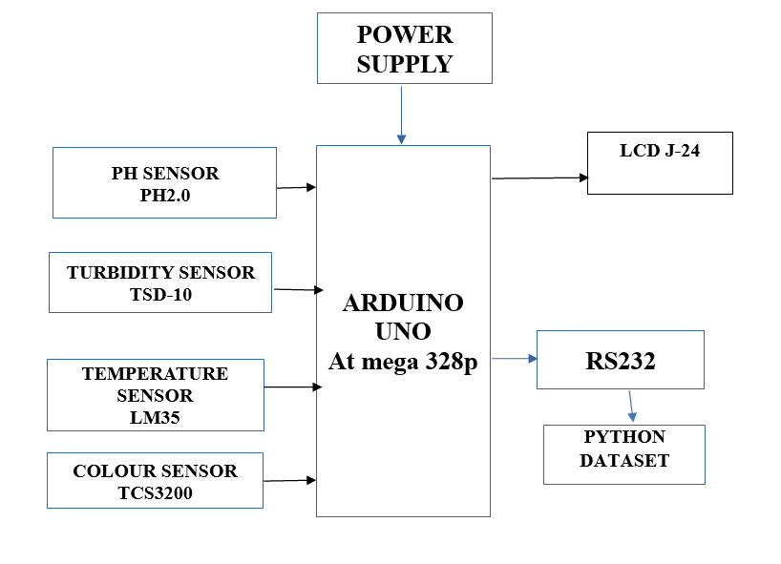
System Design-Block Diagram

Slide 19
Module Description
List of Modules:
Module 1: Data Pre-processing
Module 2: Data Visualization
Module 3: Comparing Algorithms
Module 4: Deployment Using Flask

Slide 20
Module 1-Data Pre-processing
Data Pre-processing:
Data Pre-processing is a technique that is used to convert the raw data into a clean data set.
To finding the missing value, duplicate value and description of data type whether it is float variable or integer.
Data collection, data analysis, and the process of addressing data content, quality, and structure can add up to a time-consuming to-do list.
During the process of data identification, it helps to understand your data and its properties.
Stages of Data Pre-processing:
Collected
Filtered
Sorted
Processed,Analyzed and Stored

Slide 21
Module 2-Data visualization
Data visualization is an important skill in applied statistics and machine learning.
It provides an important suite of tools for gaining a qualitative understanding. This can be helpful when exploring and getting to know a dataset and can help with identifying patterns, corrupt data, outliers, and much more.
It can be used to express and demonstrate key relationships in plots and charts that are more visceral and stakeholders than measures of association or significance.
In this project, we use “matplotlib” and “seaborn” library for data visualization.
Word clouds are a type of data visualization that can be used to visualize the most commonly used words in a text.
Examples : Graphs , Charts

Slide 22
Random Forest Algorithm
Random forest is a type of supervised machine learning algorithm based on ensemble learning. Ensemble learning is a type of learning where you join different types of algorithms or same algorithm multiple times to form a more powerful prediction model.
The random forest algorithm combines multiple algorithm of the same type i.e. multiple decision trees, resulting in a forest of trees, hence the name "Random Forest".
The random forest algorithm can be used for both regression and classification tasks.
It can handle large datasets efficiently. The random forest algorithm provides a higher level of accuracy in predicting outcomes over the decision tree algorithm.

Slide 23
Logistic Regression
Logistic regression is a Machine Learning classification algorithm that is used to predict the probability of a categorical dependent variable.
In logistic regression, the dependent variable is a binary variable that contains data coded as 1 (yes, success, etc.) or 0 (no, failure, etc.).
The goal of logistic regression is to find the best fitting model to describe the relationship between the dichotomous characteristic of interest and a set of independent variables.
Binary logistic regression requires the dependent variable to be binary.
For a binary regression, the factor level 1 of the dependent variable should represent the desired outcome.
Only the meaningful variables should be included.

Slide 24
XG Boost Classifier Algorithm
XGBoost stands for eXtreme Gradient Boosting and it’s an open-source implementation of the gradient boosted trees algorithm.
It has been one of the most popular machine learning techniques in Kaggle competitions, due to its prediction power and ease of use.
It is a supervised learning algorithm that can be used for regression or classification tasks.
It is a gradient boosting algorithm that uses decision trees as its “weak” predictors.
It provides parallel tree boosting and is the leading machine learning library for regression, classification, and ranking problems.
Supervised machine learning uses algorithms to train a model to find patterns in a dataset with labels and features and then uses the trained model to predict the labels on a new dataset’s features.

Slide 25
MLP Classifier Algorithm
MLP Classifier stands for Multi-layer Perceptron classifier which in the name itself connects to a Neural Network.
Unlike other classification algorithms such as Support Vectors or Naive Bayes Classifier, MLP Classifier relies on an underlying Neural Network to perform the task of classification.
MLP are widely used to solve problems requiring supervised learning.
MLP neural networks are commonly used by different organizations to encode databases , points of entry and routinely check the consistency of the database security.

Slide 26
Module 4-Deployment Using Flask
Deploying the model predicting output:
In this module the trained machine learning model is converted into pickle data format file (.pkl file) which is then deployed for providing better user interface and predicting the output of milk quality.
Django is a high level python web framework that enable rapid development of secure and maintainable websites.

Slide 27
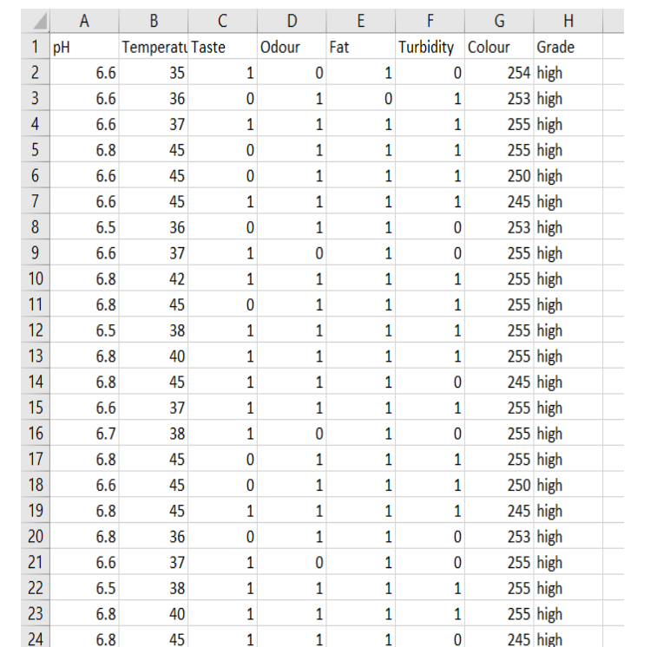
PERFORMANCE ANALYSIS
SAMPLE DATASET

Slide 28
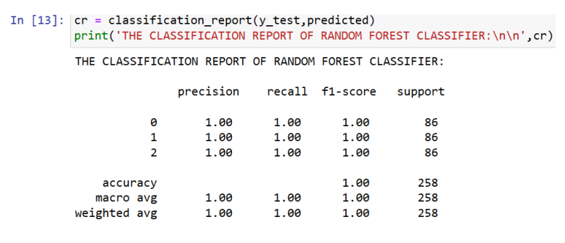
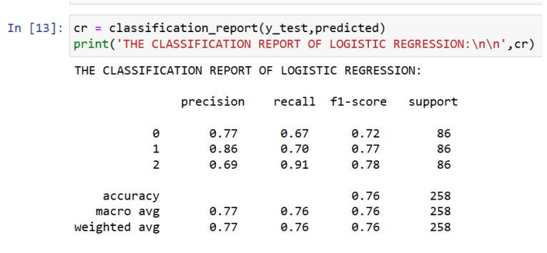
PERFORMANCE ANALYSIS
COMPARTIVE ANALYSIS
Scr 1.1 Accuarcy of Random Forest Algorithm
Scr 1.2 Accuarcy of Logistic Regression Algorithm

Slide 29
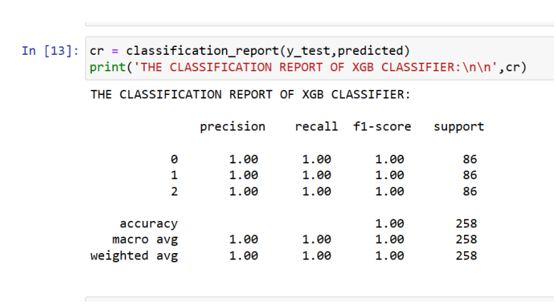
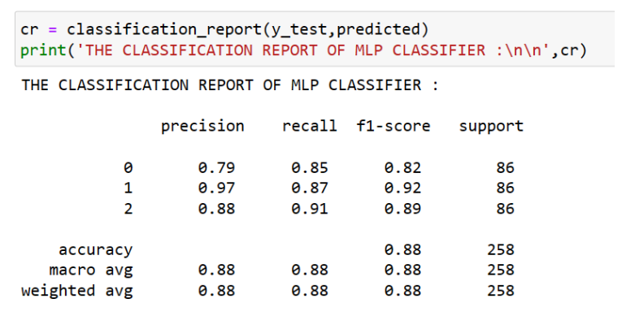
PERFORMANCE ANALYSIS
COMPARTIVE ANALYSIS
Scr 1.3 Accuarcy of XG Boost Classifier Algorithm
Scr 1.4 Accuarcy of MLP Classifier Algorithm

Slide 30

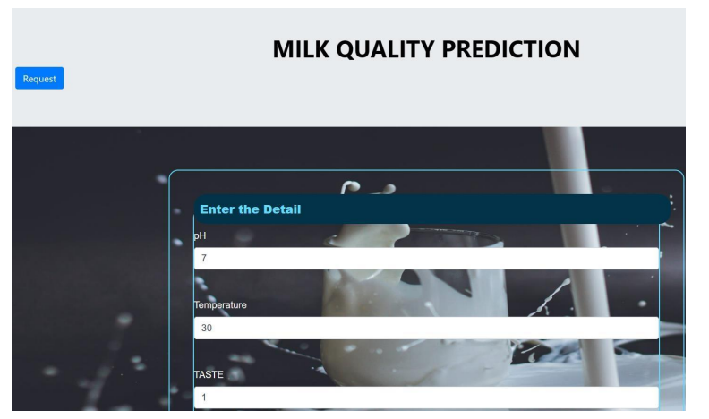
Screen Shots
Scr 1.1 User Login Web Page
Scr 1.2 Input values taken from IOT module

Slide 31
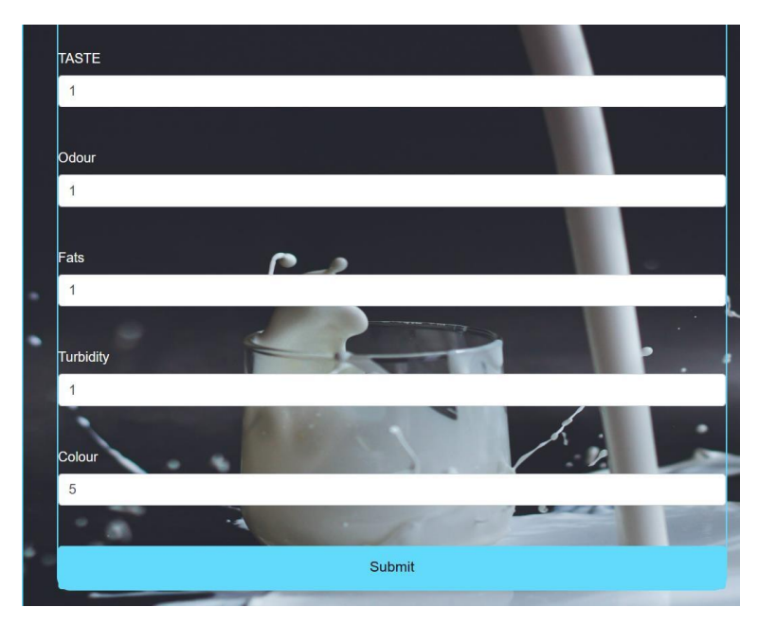
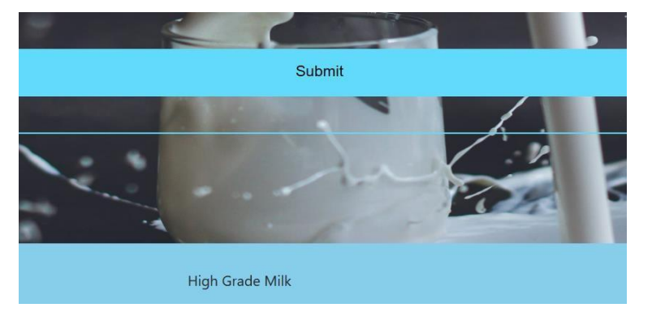
Screen Shots
Scr 1.3 Input values given by End User
Scr 1.4 Grade Prediction

Slide 32

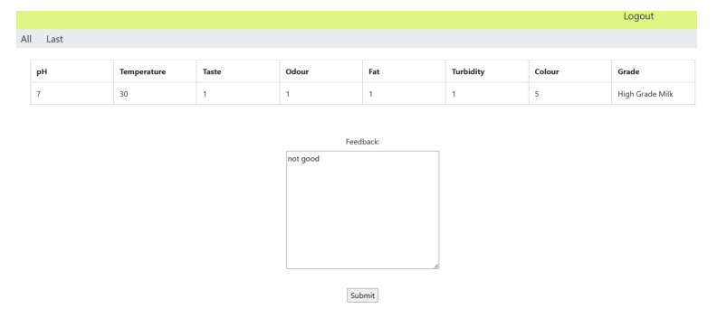
Screen Shots
Scr 1.5 Admin/Officer Login
Scr 1.6 Output Report and Admin Feedback

Slide 33

Screen Shots
Scr 1.7 Feedback Received By End User

Slide 34
Conclusion/Feature Enhancement
In this work, we proposed an analysis for attributing milk samples based on their behavioural characteristics/features following their activities.
The analytical process started from data cleaning and processing, missing value, exploratory analysis and finally model building and evaluation.
The best accuracy on public test set is higher accuracy score will be find out. This application can help to find the Prediction of Milk Quality.
This way can help the organisations to know more about the quality of milk and also will be able to identify the grades of milk.
The future works can be implemented on Milk Quality prediction which can be connected with the cloud model.
The optimization of this work can also be better if the system and the prediction model is connected with the embedded system.

Slide 35
Reference Paper/ URL
[1] R. Nagraik, A. Sharma, D. Kumar, P. Chawla, and A. P. Kumar,“Milk adulterant detection: Conventional and biosensor based approaches: A review,” Sens. Bio-Sens. Res., vol. 33, Aug. 2021.
[2] M. Chakraborty and K. Biswas, “Milk tester: Simultaneous detection of fat content and adulteration,” IEEE Trans. Instrum. Meas., vol. 69, no. 5, pp. 2468–2476, May 2020.
[3] X. Hu et al., “Use of a smartphone for visual detection of melamine in milk based on Au@Carbon quantum dots nanocomposites,” Food Chem.,vol. 272, pp. 58–65, Jan. 2019.
[4] F. Trimboli et al., “Detection of buffalo milk adulteration with cow milk by capillary electrophoresis analysis,” J. Dairy Sci., vol. 102, no. 7,pp. 5962–5970, Jul. 2019.
[5] Z. H. Zargar and T. Islam, “A novel cross-capacitive sensor for non con-tact microdroplet detection,” IEEE Trans. Ind. Electron., vol. 66, no. 6,pp. 4759–4766, Jun. 2019.
[6] T. Islam, A. Salamat, S. K. Singh, and M. Rehman, “A cross-conductive sensor to measure bottled water quality,” in Proc IEEE Int. Instrum. Meas. Technol. Conf., May 2021.

Slide 36
Reference Paper/ URL
[7] U. Salmaz, A. Salamat, and T. Islam, “Fractional order sensor for measuring the quality of milk,” Mater. Today Proc., vol. 18, pp. 1077–1089,Jan. 2019.
[8] R. Kunes et al., “In-line technologies for the analysis of important milk parameters during the milking process: A review,” Agriculture, vol. 11,no. 3, pp. 239–246, 2021.
[9] A. Costa, G. Visentin, M. De Marchi, M. Cassandro, and M. Penasa “Genetic relationships of lactose and freezing point with minerals and coagulation traits predicted from milk mid-infrared spectra in Holstein cows,” J. Dairy Sci., vol. 102, no. 8, pp. 7217–7225, Aug. 2019.
[10]Grelet, C., A. Vanlierde, M. Hostens, L. Foldager, M. Salavati, K.L. Ingvartse M. Crowe, M. T. Sorensen, E. Froidmont, C. P.Ferris, C. Marchitelli, F. Becker, T.Larsen F. Carter, and Debarring. 2019. Potential of milk mid-IR spectra to predict meta-bollic status of cows through blood components and an innovative clustering approach.

